Slide 1
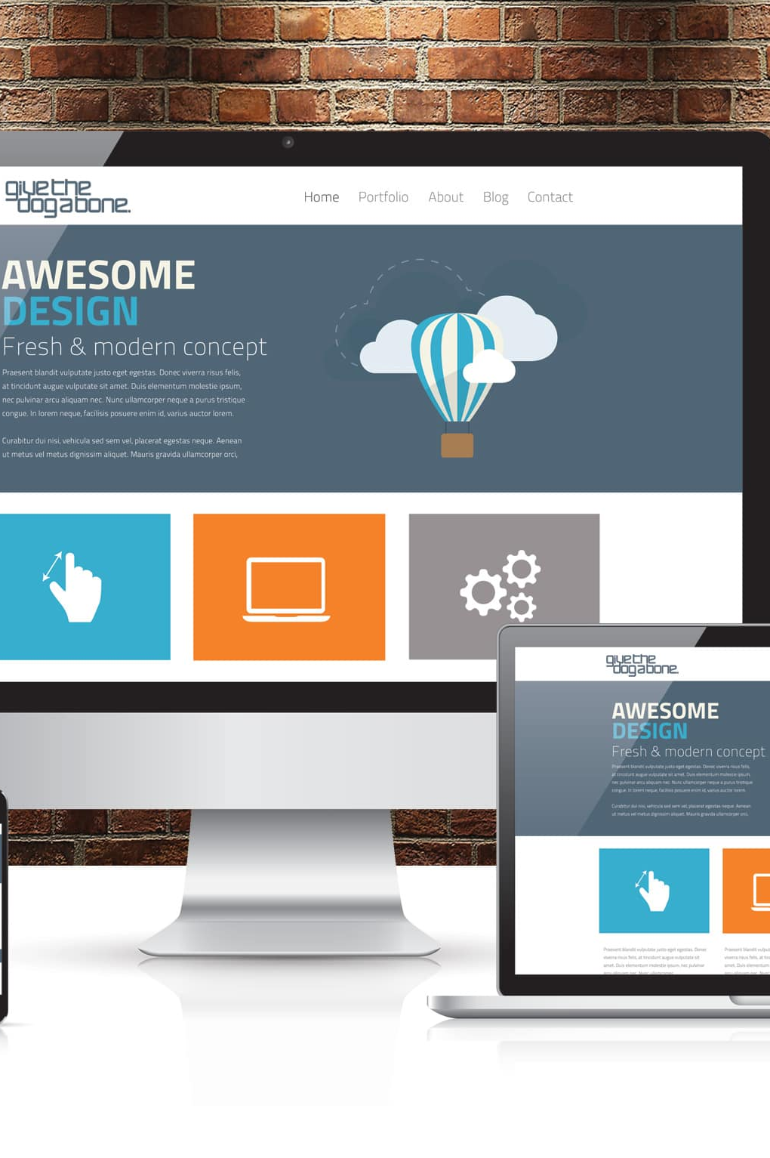
Accessible Websites
ITS ACCESSIBILITY
Create Inclusive & Accessible Experiences
December 2025
Notes:
Welcome to the workshop on accessible websites. This workshop assumes have reviewed the accessible colors and images workshops.

Slide 2

Barriers in Websites
Visual Examples
Notes:
First we’ll review a couple of barriers found on websites.

Slide 3
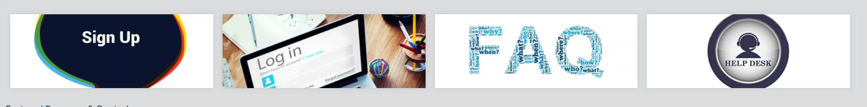
Inaccessible Links
Sighted users can often determine where a link leads based on visual context.
Screen readers will read links without meaningful descriptions as “Link.”
ITS Accessibility – Create Inclusive & Accessible Experiences
Notes:
There can be inaccessible links. Sighted users can determine where a link leads based on visual cues near the link. When links aren’t descriptive or don’t have content, they are read by a screen reader just as “Link” or if the text isn’t descriptive, such as click here, the screen reader will only read click here and the end user will not know where it’s going. In this example, a sighted person is getting the visual cues to know where each linked image is going, but if not properly identified, this demonstrates the experience for someone who can’t see and is relying on a screen reader for the information.

Slide 4
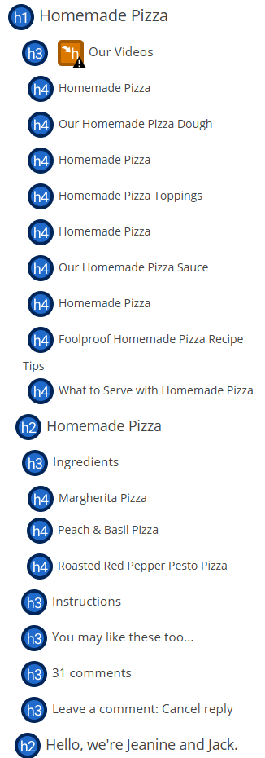
Unorganized & Unclear Headings
Headers should follow H1-H6 nesting structure.
Titles for headers need to be distinct.
Only one <H1> is permitted within a document.
ITS Accessibility – Create Inclusive & Accessible Experiences
Notes:
A second barrier is when headers are out of order or not meaningful. In this example it goes from an H1 (title of the webpage) to an H3, which skips an H2. It’s important headings are in order. Also, headings should be unique. A sighted person uses the context around headings to understand where they are on the page. But someone who relies on a screen reader requires that each heading describe what is in that section and it needs to be unique. In this example Homemade pizza isn’t descriptive enough, the name of the pizza should be included.

Slide 5
Improving Website Accessibility
A Brief Overview
Notes:
Now we’ll review ways to improve website accessibility.

Slide 6
Website Accessibility (1/2)
Website and page titles are meaningful and descriptive.
Use proper header structure (H1, H2, H3, etc.).
Alt text for images and tables.
Ensure hyperlinks are descriptive.
Use true tables with headers.
Apply sufficient color contrast and don’t rely on color for information.
ITS Accessibility – Create Inclusive & Accessible Experiences

Slide 7
Website Accessibility (2/2)
Reading and navigation order is logical.
Functionality is available using keyboard only (no traps).
Skip to content available.
Captions and transcripts are available for videos.
Ensure files are accessible (PDF, Word, PPTx, etc.).
Check accessibility using tools available.
ITS Accessibility – Create Inclusive & Accessible Experiences

Slide 8
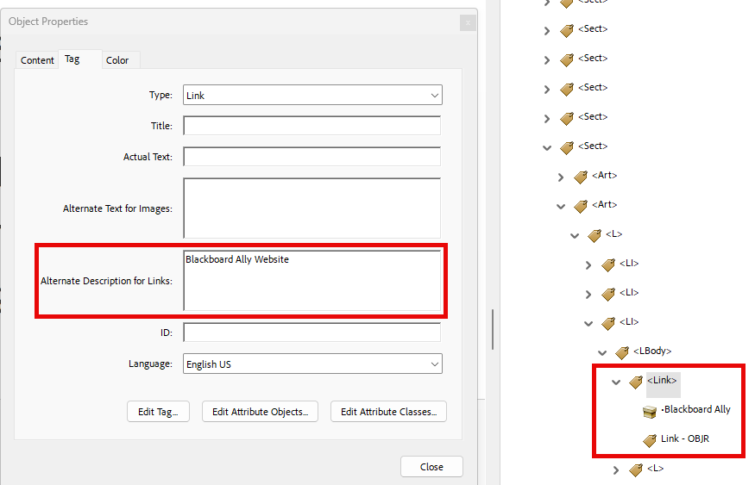
Descriptive Tagged Hyperlinks
Screen reader users navigate websites tabbing link to link.
Write text display to indicate link page.
  Do not use “click here,” “learn more,” “read more” as text display.
Example:
  BlackBoard Ally
Don’t underline text that isn’t a link.
  Keyboard only users may think it’s a link and can’t access it by tabbing.
ITS Accessibility – Create Inclusive & Accessible Experiences
Notes:
Sighted users can visually scan a document or webpage to identify links, which are usually bold and underlined. Users who are blind rely on screen readers and navigate by pressing the Tab key to move through links. Screen readers only announce the link text, not the surrounding content. If a link says “Click here,” the user has no idea where it leads. Instead, use descriptive link text, such as “Download the Accessibility Guide.”
This is important: Do not underline text that isn’t a hyperlink. Sighted users who can’t use a mouse and can only navigate with a keyboard may assume it’s a link and try to tab to it, which can cause confusion.

Slide 9
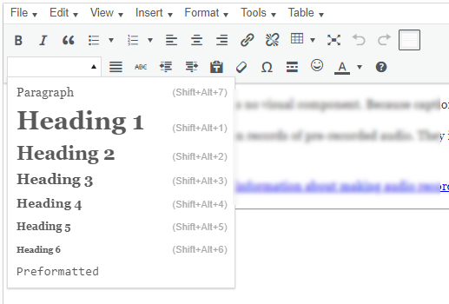
Using Structured Website Headings
Use structure when selecting headings (not just font size).
There is one heading 1 on page
ITS Accessibility – Create Inclusive & Accessible Experiences
Notes:
Headings provide structure and organization to a webpage, making it easier for screen readers to navigate. They allow users with visual impairments to jump between sections quickly instead of reading line by line. Proper heading styles (Heading 1, Heading 2, etc.) create a logical hierarchy that improves readability and ensures that assistive technologies can interpret the webpage correctly. There is only one heading one on a webpage. The main sections are heading twos and subsections are heading threes.

Slide 10
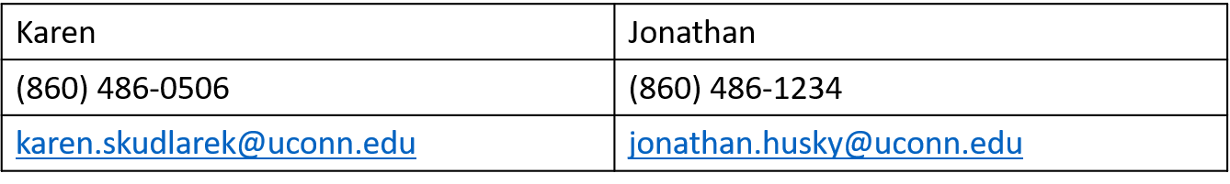
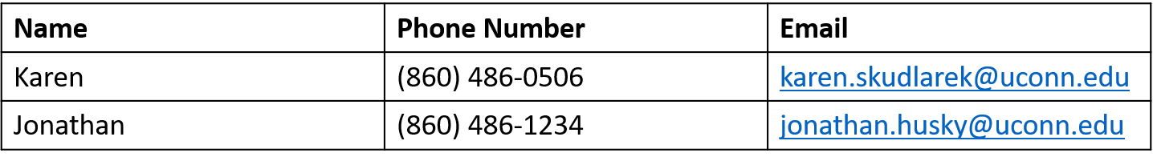
True Tables
Inaccessible Table
The presence of headings is the primary difference between an inaccessible and accessible true table.
Accessible Table
ITS Accessibility – Create Inclusive & Accessible Experiences
Notes:
Here are two examples of tables. The first is inaccessible because it was used only for layout purposes and doesn’t contain headings. Tables are read from left to right and down. If this table had more rows, it would be very difficult to understand which phone number is associated with which person. The table below it is accessible because it has headers and the data is same for each column making it much easier for someone with a screen reader to access the data.

Slide 11
Reading Order & Keyboard Navigation
Screen reader users navigate websites using keyboard only
  Ensure reading order and navigation is logical
  Ensure functionality using keyboard only (no traps)
  Skip to Content, Skip to Navigation, Skip to Search are available
Screen reader users can navigate websites by tabbing link to link
  Ensure links are meaningful
Screen reader users also navigate using up/down arrow keys.
Use a screen reader with keyboard only to test a webpage for accessibility.
ITS Accessibility – Create Inclusive & Accessible Experiences
Notes:
Screen reader users typically navigate websites using only the keyboard, so it’s critical to ensure that the reading order and navigation flow are logical. This means that as they move through the webpage, the sequence should make sense and follow the intended structure of the page.
Also, verify that all functionality works with keyboard-only navigation—there should be no keyboard traps where a user gets stuck and cannot move forward or backward. Providing shortcut links like Skip to Content or Skip to Navigation or Skip to Search is essential because they allow users to bypass repetitive navigation and jump directly to the main content, menu or search. If you are using UConn’s Aurora WordPress platform, these keyboard shortcut links are automatically included.
The tab key and shift-tab keys are used to navigate links. The up and down arrows are used to navigate all the content on a page.

Slide 12
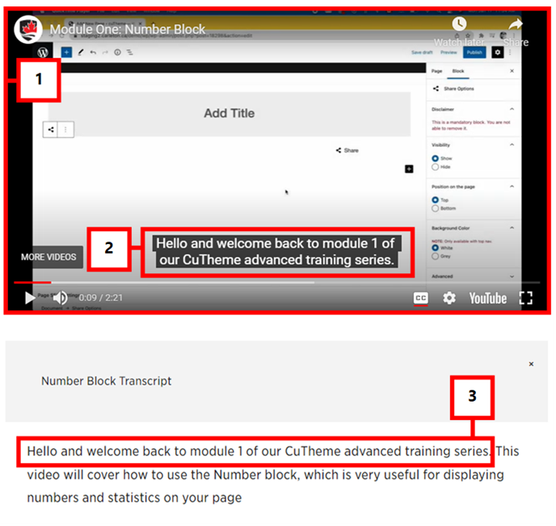
Include Captions & Transcripts
Ensure videos are shared from a video platform such as Kaltura or YouTube.
If not, then captions must be burned into the video (open captions).
Edit and validate any auto generated captions.
ITS Accessibility – Create Inclusive & Accessible Experiences
Notes:
When sharing videos, always make sure they are accessible. The easiest way to do this is by using a video platform like Kaltura or YouTube, which supports captions and transcripts. These platforms allow viewers to turn captions on or off and often provide tools for editing captions.
If you’re not using a platform that supports captions, then captions must be burned into the video—this is called open captions. Open captions are permanently visible and ensure that everyone can access the spoken content.
Finally, if you use auto-generated captions, don’t assume they’re accurate. Always edit and validate them to correct errors in spelling, punctuation, and timing. Accurate captions are essential for people who are deaf or hard of hearing and also benefit anyone watching in a noisy environment or without sound.

Slide 13
Accessibility Issues on UConn Websites
Illogical heading structure.
Broken links, including indiscernible text (empty links).
Insufficient color contrast.
Images without alt text.
Videos without captions.
ITS Accessibility – Create Inclusive & Accessible Experiences
Notes:
These are the top five issues found on UConn websites, including ill structured headings, broken links, insufficient color contrast, images without alt text (or poorly written alt text), and videos without captions.

Slide 14
Website Accessibility Checkers
Online Resources
Notes:
Next we’ll review tools available to check websites for accessibility.

Slide 15
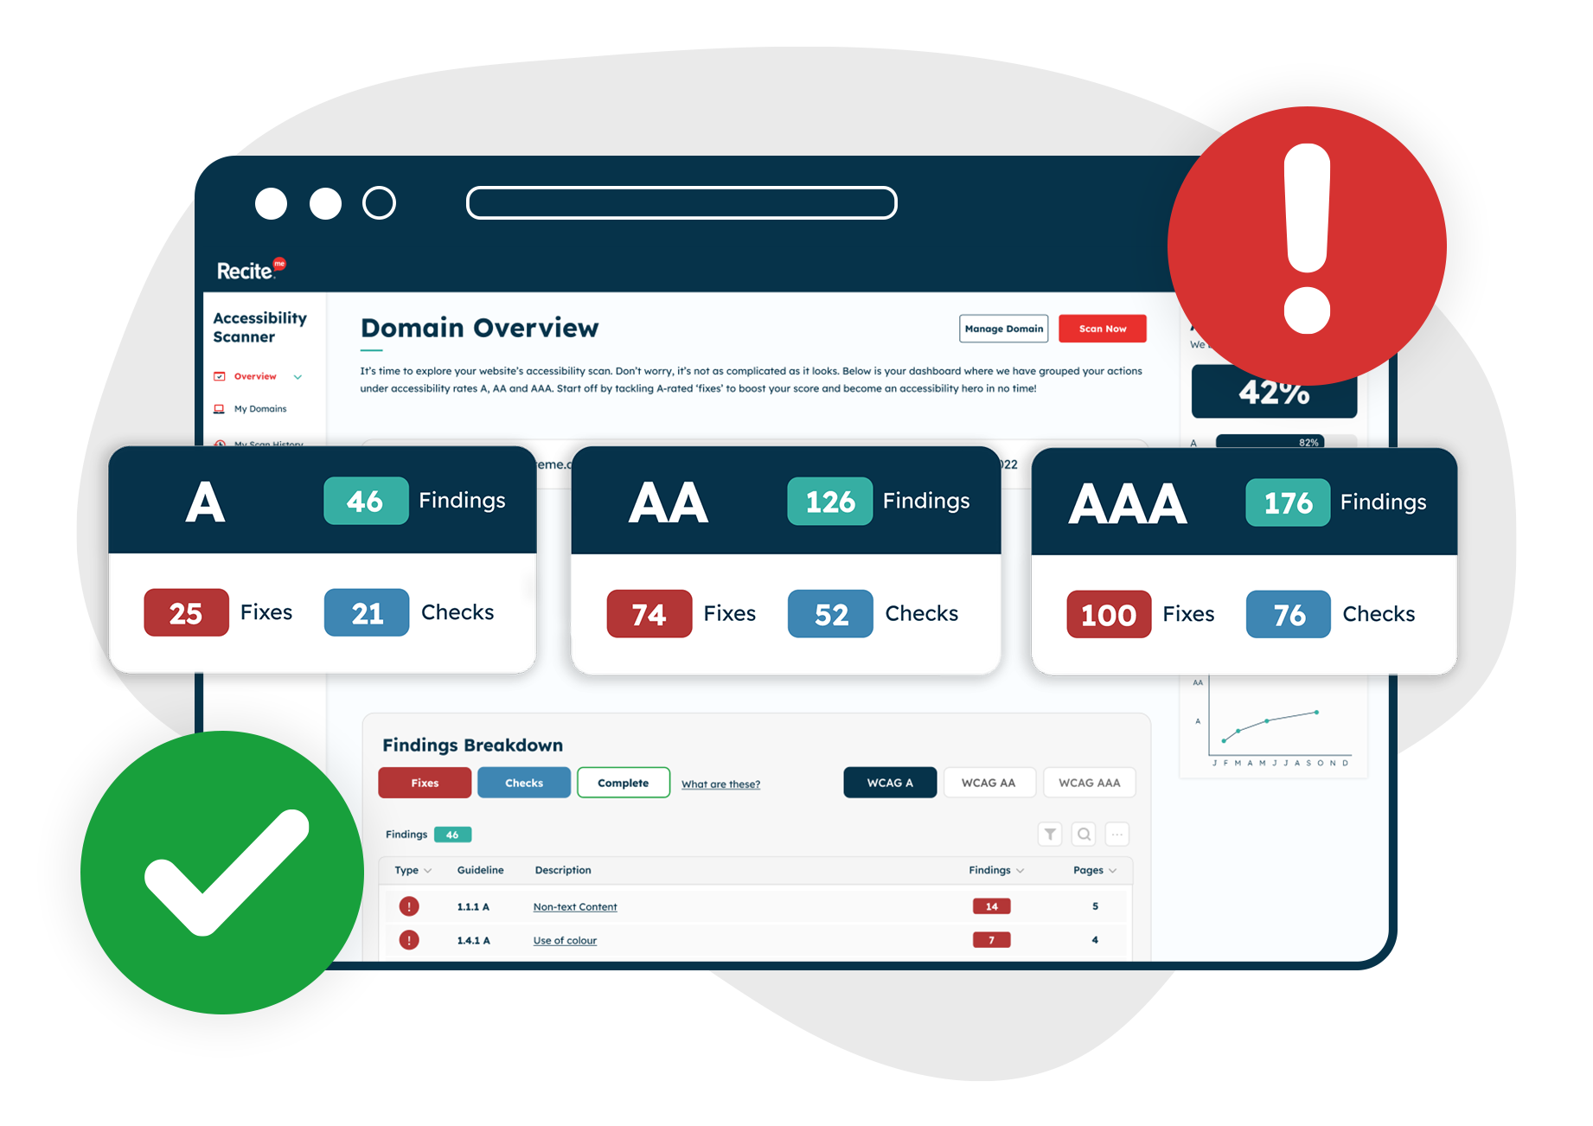
Tools to Check Websites
WAVE by WebAIM
  Free browser extension.
  Displays code for webpage.
Blackboard Ally
  Scans weekly and offers a score for the site.
  Also found in HuskyCT Courses and Organizations.
Siteimprove
  Admins can email itaccessibility@uconn.edu to get access.
ITS Accessibility – Create Inclusive & Accessible Experiences
Notes:
There are several tools available to help check website accessibility:
First, WAVE by WebAIM is a free browser extension that provides an easy way to evaluate accessibility on individual pages. It highlights issues directly on the page and even displays the underlying code, making it useful for developers and content creators.
Next, Blackboard Ally is a tool that scans websites weekly and provides an accessibility score for the site. It’s also integrated into HuskyCT Courses and Organizations, so instructors and course designers can use it to improve accessibility with their content.
Finally, Siteimprove is another powerful tool for accessibility monitoring and reporting. Access to Siteimprove is available for admins by emailing itaccessibility@uconn.edu. This tool provides detailed insights and ongoing monitoring to ensure compliance and usability.
These tools are essential for maintaining accessibility standards and creating an inclusive experience for all users.

Slide 16
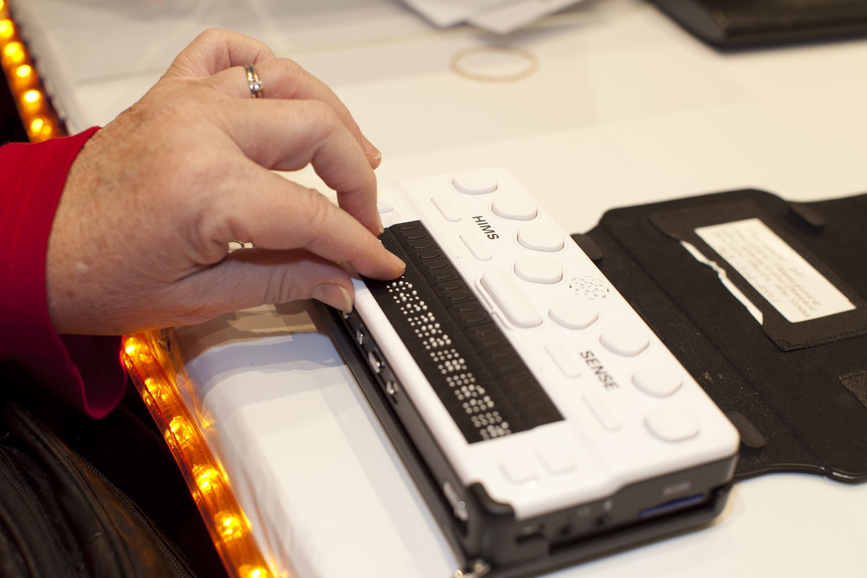
Most Common Screen Readers
NVDA
  Free, Windows only.
Mac: VoiceOver
JAWS
  For purchase.
  Most popular screen reader.
Windows: Narrator
ITS Accessibility – Create Inclusive & Accessible Experiences
Notes:
Screen readers are essential tools for people who are blind or have low vision, and it’s important to understand the most commonly used ones:
NVDA is a free screen reader available only for Windows. It’s widely used because it’s open-source and offers robust functionality without cost.
On Mac, the built-in screen reader is VoiceOver. It comes pre-installed on all Apple devices, making it easily accessible for Mac users.
Windows also includes Narrator, a built-in screen reader. It provides basic functionality and is useful for quick access.
JAWS is the most popular screen reader overall, but it requires a paid license. It’s known for its advanced features and strong compatibility with Windows applications.
You can use a screen reader to test content for accessibility across different platforms.

Slide 17
Accessible Website Checklist
Website and page titles are meaningful with properly heading structure.
Alt text is used for images and tables.
Hyperlinks are descriptive and true tables have headers.
Color contrast is adequate; includes labels and icons to convey meaning.
Reading and navigation order is logical.
Keyboard functionality exists (no traps) with skip to content feature.
Captions and transcripts are available for videos.
Files are all accessible (PDF, Word, PPTx, etc.).
Check accessibility using tools available (WAVE, Sally Bb Ally).
ITS Accessibility – Create Inclusive & Accessible Experiences
Notes:
You can use this checklist to make sure that you’re meeting the accessibility requirements for websites.

Slide 18

Thank You!
ACCESSIBLE WEBSITES
UConn ITS Accessibility
accessibility.its.uconn.edu
Notes:
Thank you for your time and please, check out the other workshops related to accessibility.

Slide 19
University of Connecticut Wordmark

