Slide 1
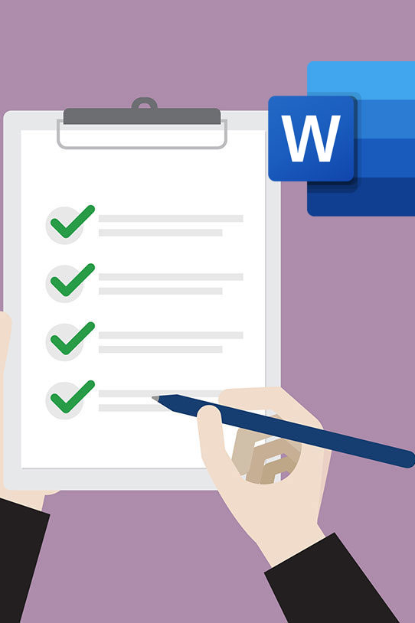
Accessible Digital Content/Apps
ITS ACCESSIBILITY
Create Inclusive & Accessible Experiences
March 2026

Slide 2
A Thought
Disability: The world’s largest minority. The world’s most diverse minority. The only minority group anyone can join at any moment in their lives. And at some point, if we live long enough, we will likely age into the community.
– Sandy Lacey, Executive Director of the Howe Innovation Center
ITS Accessibility – Create Inclusive & Accessible Experiences

Slide 3
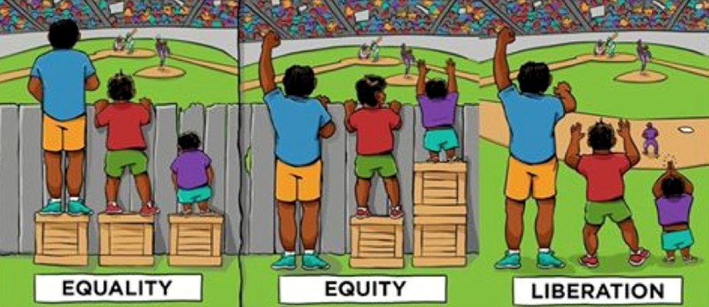
Accommodation vs. Accessibility
In this graphic, the left panel represents inaccessibility; the middle panel represents accommodation; and the right panel represents accessibility.
ITS Accessibility – Create Inclusive & Accessible Experiences

Slide 4
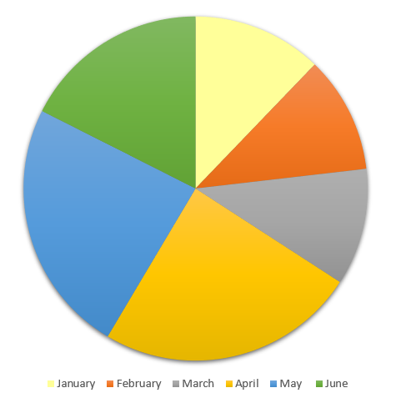
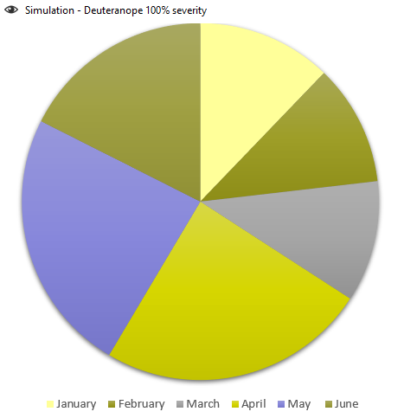
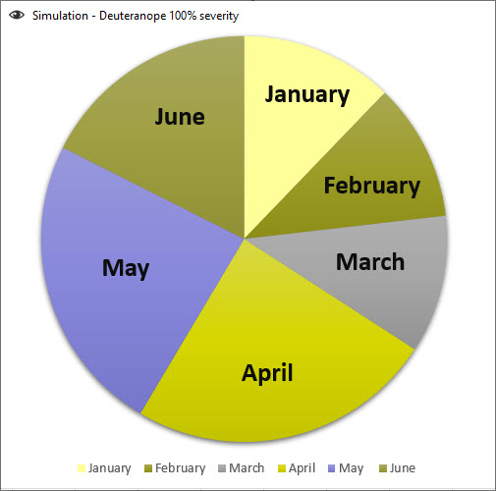
Inaccessible Colors
ITS Accessibility – Create Inclusive & Accessible Experiences

Slide 5
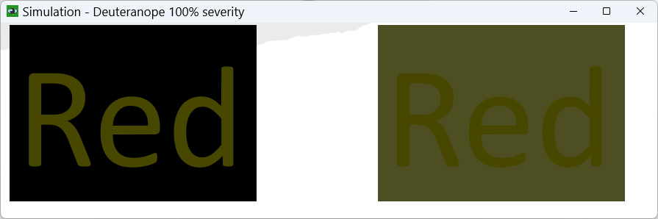
Red/Green Deficiency
Red
Red
ITS Accessibility – Create Inclusive & Accessible Experiences

Slide 6

Inadequate Color Contrast
You don’t want to read this.
The ratio for these two colors is a 1.009:1 which is barely better than comparing a color to itself (1:1).
ITS Accessibility – Create Inclusive & Accessible Experiences

Slide 7
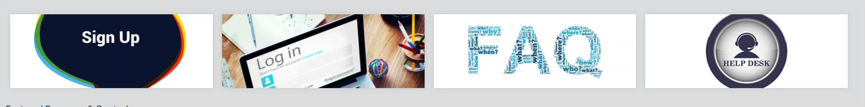
Lack of Descriptive Hyperlinks
ITS Accessibility – Create Inclusive & Accessible Experiences

Slide 8
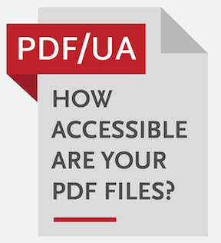

No Tags
ITS Accessibility – Create Inclusive & Accessible Experiences

Slide 9
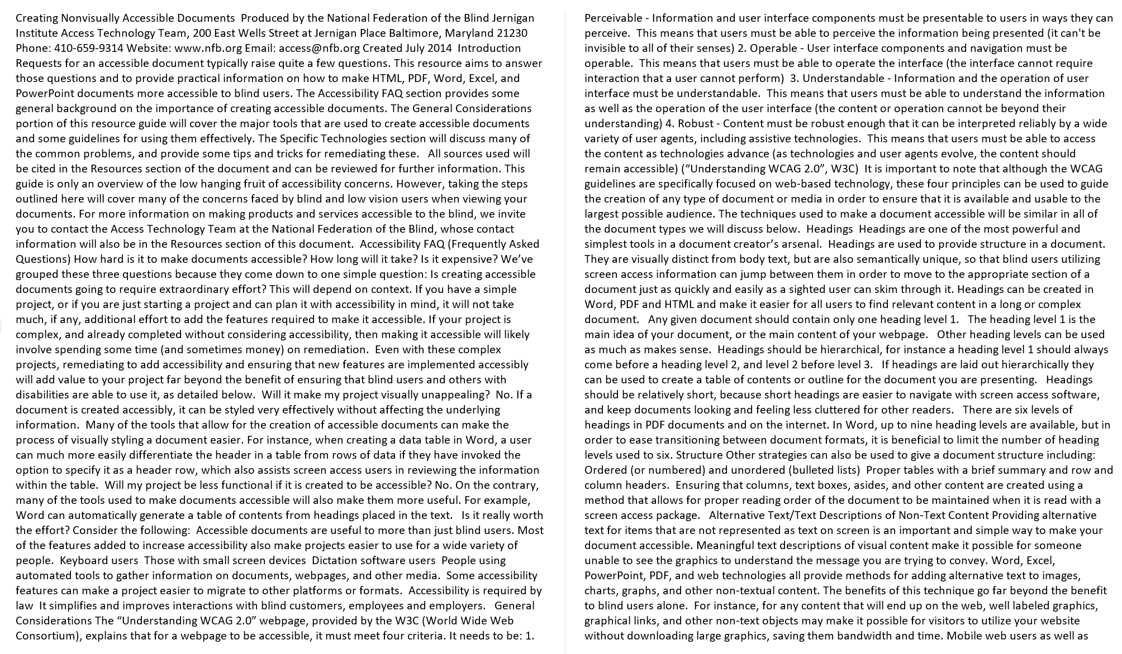
No Headings
ITS Accessibility – Create Inclusive & Accessible Experiences

Slide 10
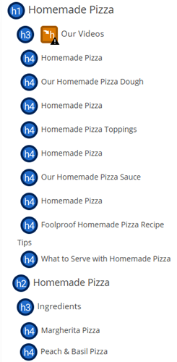
Headings Out of Order or Not Meaningful
ITS Accessibility – Create Inclusive & Accessible Experiences

Slide 11
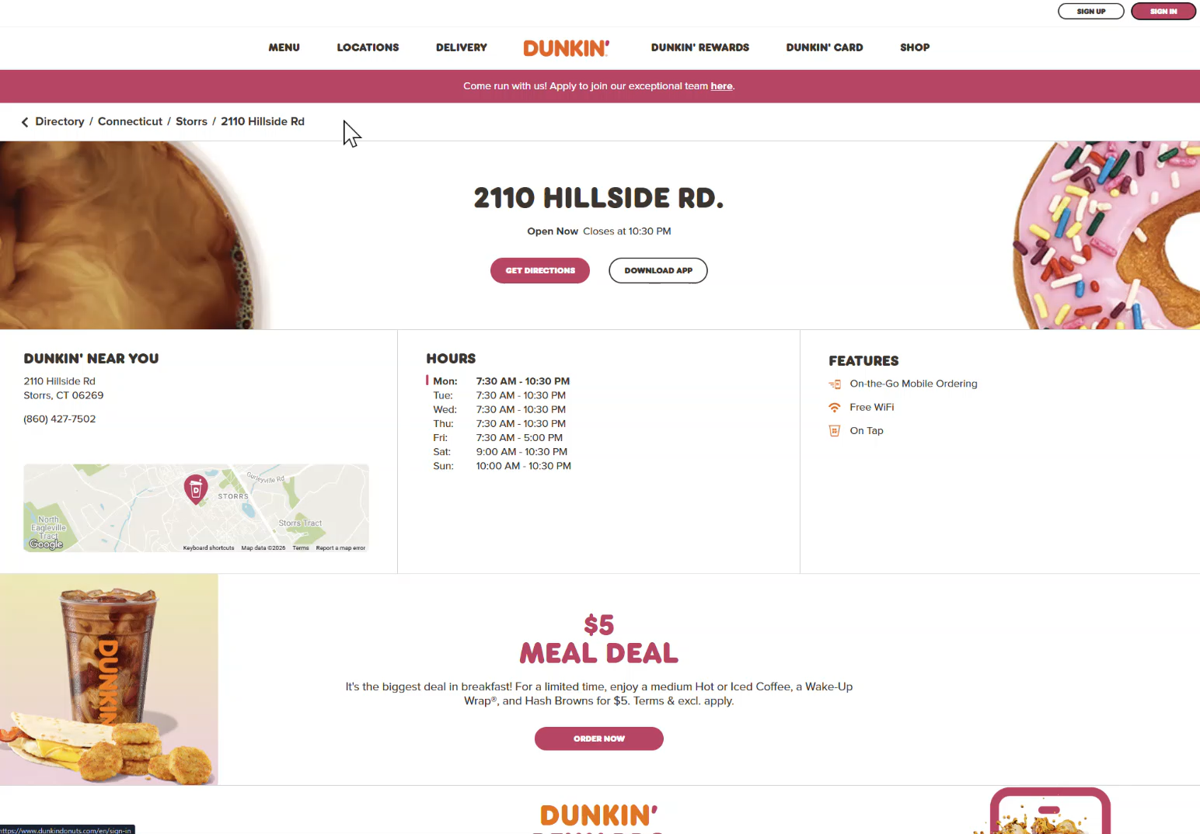
Dunkin’ Website
ITS Accessibility – Create Inclusive & Accessible Experiences

Slide 12
Why We’re Here
Accessibility is about ensuring anyone, (students, staff, faculty, alumni, public), can use UConn websites, apps, and other technology
If your website or platform is public-facing, accessibility is not optional - it’s part of publishing.
Accessibility improves access, clarity, structure, and professionalism.
ITS Accessibility – Create Inclusive & Accessible Experiences

Slide 13
Why Does Accessibility Matter in Academia?
Ethical Reasons
  Ensures all readers, including those using screen readers, can read & navigate your work
  Supports neurodiverse and disabled scholars
  Aligns with principles of universal design
Practical Reasons
  Accessible pages and documents are easier to read and revise
  Accessibility improves SEO, clarity, and consistency, not just compliance
Legal & Institutional Reasons
  Universities must follow ADA; inaccessible dissertations can create risk
  Increasing expectations from federal agencies
ITS Accessibility – Create Inclusive & Accessible Experiences

Slide 14
Changes in the Law
New ADA Title II Digital Accessibility Regulations (effective April 24, 2026)
Standard of compliance: WCAG 2.1 Level AA (foundation of digital accessibility)
ADA Title II now explicitly covers public‑facing digital content, including:
  University websites
  Course materials
  PDF and other documents
Content created on or after April 2024 or still in use must be accessible
Applies to all public universities, including UConn
ITS Accessibility – Create Inclusive & Accessible Experiences

Slide 15
WCAG: Foundation of Digital Accessibility
POUR = The four requirements for accessible web content
Perceivable: can see or hear the content
Operable: can navigate and use it, especially with a keyboard
Understandable content and navigation make sense
Robust: works reliably with assistive technologies now and in the future
ITS Accessibility – Create Inclusive & Accessible Experiences

Slide 16
WCAG: Perceivable
Content must be presented in ways users can perceive
Text alternatives for images
Sufficient color contrast
Captions for video
ITS Accessibility – Create Inclusive & Accessible Experiences

Slide 17
WCAG: Operable
Users must be able to navigate and interact with the site
Fully usable with a keyboard
Clear focus indicators
Logical navigation order
ITS Accessibility – Create Inclusive & Accessible Experiences

Slide 18
WCAG: Understandable
Content and interactions must be easy to understand
Clear headings and link text
Consistent navigation
Helpful error messages
ITS Accessibility – Create Inclusive & Accessible Experiences

Slide 19
WCAG: Robust
Content must work reliably with different technologies
Proper HTML structure
Compatible with screen readers and browsers
Works now and in the future
ITS Accessibility – Create Inclusive & Accessible Experiences

Slide 20
What Does This Mean for Website Admins?
Public‑facing UConn websites must meet WCAG 2.1 AA standards
Accessibility is part of publishing content, just like accuracy and branding
New and updated content must be accessible at launch
Existing content that remains in use must be remediated over time
Siteimprove helps identify, prioritize, and track issues
ITS Accessibility – Create Inclusive & Accessible Experiences

Slide 21
What Does This Mean for Content Creators?
Examples of Content:
  PDFs, Word docs, spreadsheets, Webpage content, Forms, instructions, and reports, Images and graphics, Content shared via email or websites
  Use Built‑In Structure (Don’t “Design by Appearance”)
  Does it need to be a document?
  Ensure Documents Are Accessible Before Sharing
ITS Accessibility – Create Inclusive & Accessible Experiences

Slide 22
Resources Available
People
  IT Accessibility Coordinator (karen.skudlarek@uconn.edu)
  General mailbox: itaccessibility@uconn.edu
  Marketing/Communicators for schools/colleges/departments
IT Accessibility Website
  Workshops
  Best Practice
Website Accessibility Monitoring: Siteimprove and Blackboard Ally
Free File Accessibility Checkers
  Microsoft Office, PDF UA Checker
ITS Accessibility – Create Inclusive & Accessible Experiences

Slide 23
Siteimprove
UConn has over 150,000 of web pages across over 1,500 sites. Siteimprove helps you find, prioritize, and fix issues efficiently.
It checks:
  WCAG 2.1 AA
  Links
  Readability
  PDFs (but Blackboard Ally does this better right now)
You don’t need to be an accessibility expert, Siteimprove helps guide you
ITS Accessibility – Create Inclusive & Accessible Experiences

Slide 24
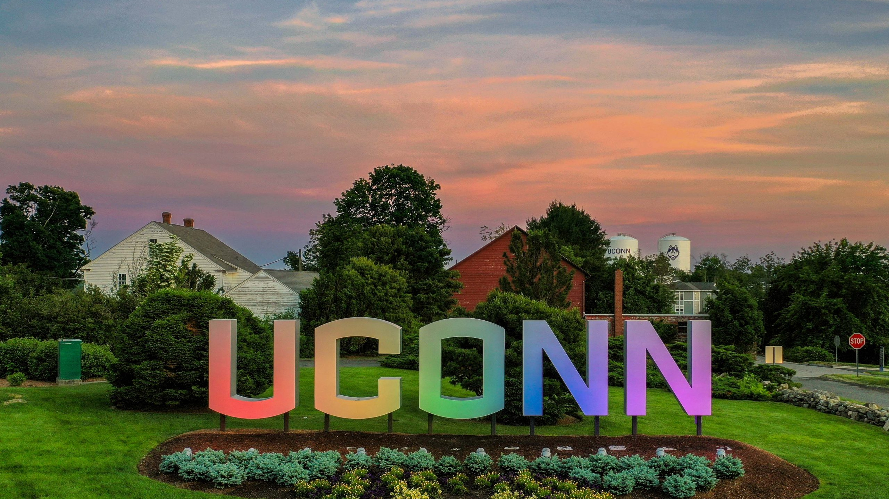
Thank You!
ACCESSIBLE DIGITAL CONTENT/APPS
UConn ITS Accessibility
accessibility.its.uconn.edu

Slide 25
University of Connecticut Wordmark

