Slide 1
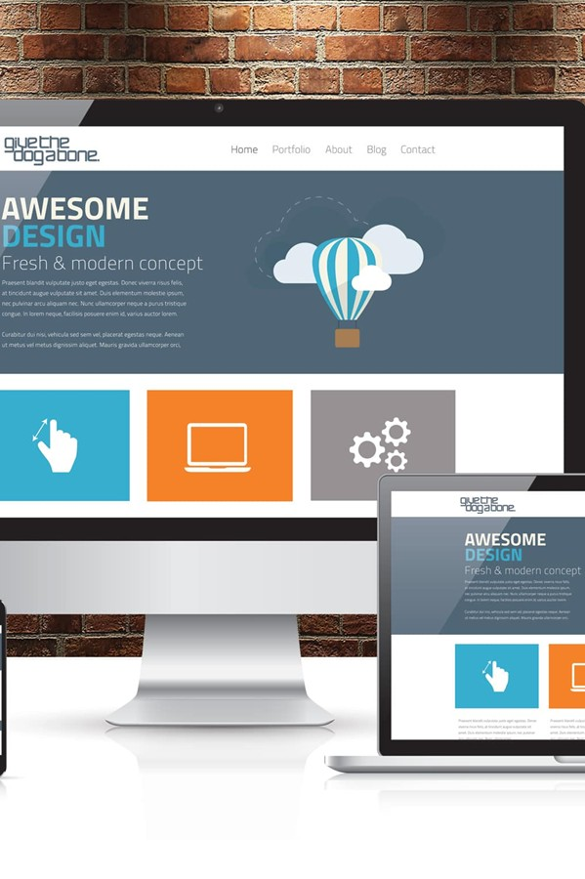
Accessible Practices that Improve Learning: Practical UDL Strategies for Faculty
ITS ACCESSIBILITY
Create Inclusive & Accessible Experiences
May 2026

Slide 2
A Thought
Disability: The world’s largest minority. The world’s most diverse minority. The only minority group anyone can join at any moment in their lives. And at some point, if we live long enough, we will likely age into the community.
– Sandy Lacey, Executive Director of the Howe Innovation Center
ITS Accessibility – Create Inclusive & Accessible Experiences

Slide 3
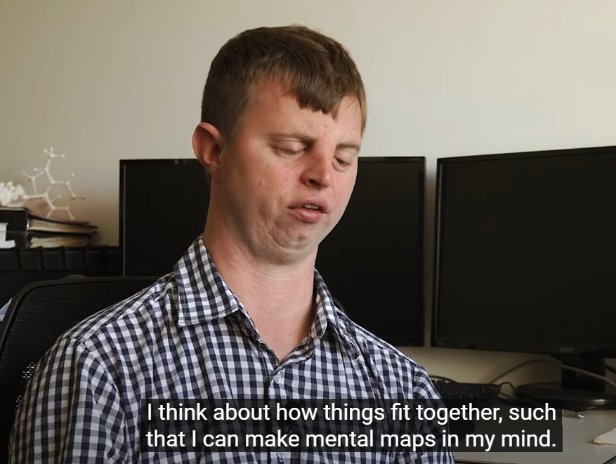
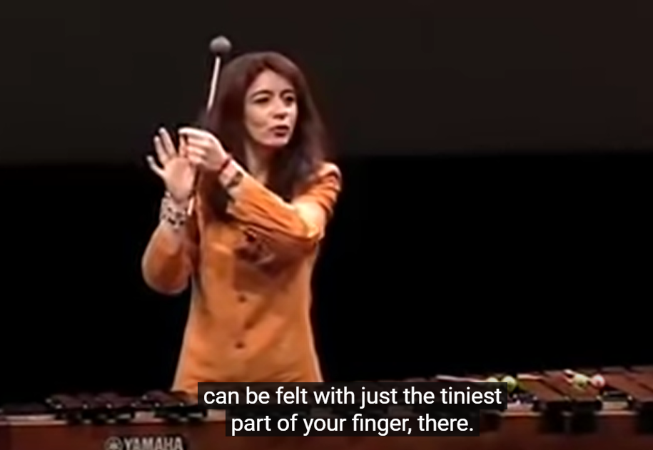
Why Do We Need to Create an Accessible Classroom?
Evelyn Glennie: Percussionist performed with Philharmonic Orchestra, Deaf at 12
Hoby Wedler: PhD Chemistry UC Davis, Blind at Birth
ITS Accessibility – Create Inclusive & Accessible Experiences

Slide 4
2023 United States Statistics: Individuals (21-64) with and without Disability
Bachelor’s Degree or more
without disability: 39.2%
with disability: 19.7%
Employment
without disability: 77.9%
with disability: 41.8%
Source: https://disabilitystatistics.org/
ITS Accessibility – Create Inclusive & Accessible Experiences

Slide 5
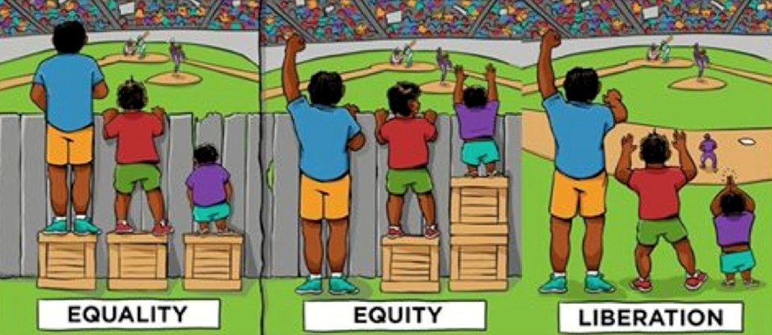
Accommodation vs. Accessibility
In this graphic, the left panel represents inaccessibility; the middle panel represents accommodation; and the right panel represents accessibility.
ITS Accessibility – Create Inclusive & Accessible Experiences

Slide 6
Why Does Accessibility Matter in Academia?
Ethical Reasons
  Ensures all readers, including those using screen readers, can read & navigate your work
  Supports neurodiverse and disabled learners and scholars
  Aligns with principles of universal design for learning
Practical Reasons
  Accessible pages and documents are easier to read and revise
Legal & Institutional Reasons
  UConn is a public university that believes in the "freedom of academic inquiry and expression,” and equitable access is pivotal
  Universities must follow ADA Title II regulations
  Increasing expectations from federal agencies
ITS Accessibility – Create Inclusive & Accessible Experiences

Slide 7
Why Does Accessibility Matter for Instructors?
What gets in the way of student learning?
Unclear instructions
Poorly structured documents
Inaccessible PDFs
Overly complex layouts
When students struggle with format, clarity, or access, we’re not measuring learning, we’re measuring barriers.
ITS Accessibility – Create Inclusive & Accessible Experiences

Slide 8
Accessible Design Supports Learning & Assessment
Increases student understanding of content and expectations
Reduces confusion unrelated to learning goals
Improves engagement and persistence
Supports equitable demonstration of learning
Produces more valid assessment results
Accessible design leads to more accurate evidence of student learning.
ITS Accessibility – Create Inclusive & Accessible Experiences
Notes:
If students struggle because of format, structure, or access, we’re not measuring learning—we’re measuring barrier navigation.
Accessibility helps ensure assessments reflect what students know and can do.
This aligns directly with assessment, closing the loop, and equity in learning outcomes.
“Accessible design is often the first and most practical way faculty already support Universal Design for Learning, whether or not they call it that.”

Slide 9
Who Benefits from Accessible Design?
Students with disabilities (documented or undocumented)
Multilingual learners
Students new to academic discourse
Students accessing content on mobile devices
Students juggling work, caregiving, or fatigue
Faculty assessing student learning
ITS Accessibility – Create Inclusive & Accessible Experiences
Notes:
Accessibility is not about a small group—it reflects how students actually engage with content.
Many barriers show up only in certain contexts: fatigue, stress, small screens, poor internet, unfamiliar formats.
Faculty benefit directly: fewer clarification emails, stronger submissions, clearer assessment outcomes.

Slide 10
Changes in Accessibility Law
New ADA Title II Digital Accessibility Regulations (effective April 26, 2027)
Standard of compliance: WCAG 2.1 Level AA (foundation of digital accessibility)
ADA Title II now explicitly covers public‑facing digital content, including:
  University websites
  Course materials
  PDF and other documents
Content created on or after April 2024 or still in use must be accessible
Applies to all public universities, including UConn
ITS Accessibility – Create Inclusive & Accessible Experiences

Slide 11
Accessibility Is Not Just Compliance
Compliance Framing | Learning & Assessment Framing
Legal requirement | Teaching strategy
Reactive | Proactive
Fixing problems | Preventing barriers
Individual accommodations | Designed for all students
Accessibility can be one of the most effective, yet underutilized teaching strategies.
ITS Accessibility – Create Inclusive & Accessible Experiences
Notes:
UDL is often introduced as a big framework, but at its core it’s about barrier reduction.
Accessibility is one of the most concrete, actionable ways faculty already support UDL—sometimes without calling it that.
This session focuses on what faculty can directly control: how content is presented, structured, and assessed.

Slide 12
Constraints Are Real
Instructors have limited time
Competing priorities (teaching, research, service)
Large class sizes
A large volume of existing materials that may need review or updates
Varying levels of comfort with technology
Uncertainty about what “good” accessibility looks like
This is not about redesigning everything, it’s about small, high impact changes.
ITS Accessibility – Create Inclusive & Accessible Experiences

Slide 13
What Is the Goal?
The goal isn’t to redesign everything.
You do not need to fix everything at once
You do not need to become an accessibility expert
You do not need to throw away existing materials
The goal is to make small, intentional changes that reduce barriers and improve learning over time.
Build on what you already have
Focus on high impact areas
Improve over time
ITS Accessibility – Create Inclusive & Accessible Experiences
Notes:
You can build on what you already have
Small changes can have a big impact on learning and assessment

Slide 14





Assistive Technologies Used by Students
Screen Reader | Themes | On-Screen Keyboards and Sticky Keys | Screen Magnifier | On-Screen Alerts
Text to speech Reads out the information on the screen Assists people who are blind or vision impaired | Creates high contrast (e.g. white on black) Increases mouse pointer and text size Assists people with color blindness and low vision | On-screen keyboard allows typing using a pointing devices rather thana keyboard Sticky keys allows commands to be typed, avoiding the need to hold down multiple keys Assists people with mobility issues | Enlarges screen content Assists people with low vision | Visual messages in place of audible sounds Assists people who are deaf or hearing impaired
ITS Accessibility – Create Inclusive & Accessible Experiences

Slide 15
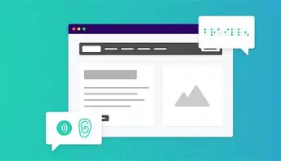
Assistive Technology:
Screen Readers
Read content aloud
Navigate using headings, links, landmarks
Interpret structure (if properly tagged)
NVDA
  Free, Windows only
JAWS
  Paid, Windows only
Mac: VoiceOver​
Windows: Narrator​
“Screen readers depend entirely on structure and labels, not visuals.”
ITS Accessibility – Create Inclusive & Accessible Experiences
Notes:
Screen readers are essential tools for people who are blind or have low vision, and it’s important to understand the most commonly used ones:
NVDA is a free screen reader available only for Windows. It’s widely used because it’s open-source and offers robust functionality without cost.
On Mac, the built-in screen reader is VoiceOver. It comes pre-installed on all Apple devices, making it easily accessible for Mac users.
Windows also includes Narrator, a built-in screen reader. It provides basic functionality and is useful for quick access.
JAWS is the most popular screen reader overall, but it requires a paid license. It’s known for its advanced features and strong compatibility with Windows applications.
You can use a screen reader to test content for accessibility across different platforms.

Slide 16
UDL Through an Accessibility Lens

Slide 17
UDL: A Focus on Reducing Barriers
Anticipates learner variability
Reduces barriers before students encounter them
Emphasizes flexibility without lowering expectations
Accessibility is a practical starting point for UDL
UDL helps us design for variability, accessibility helps us remove the barriers that get in the way.
ITS Accessibility – Create Inclusive & Accessible Experiences
Notes:
UDL is often introduced as a big framework, but at its core it’s about barrier reduction.
Accessibility is one of the most concrete, actionable ways faculty already support UDL—sometimes without calling it that.
This session focuses on what faculty can directly control: how content is presented, structured, and assessed.

Slide 18
High Impact Change 1: Make Structure Visible
Headings in documents (use styles in Word)
Unique slide titles in PowerPoint
  Ensure reading order is accurate
Clear modules or sections in your course
Impact:
Easier navigation
Better comprehension
Supports screen readers
Students focus on content, not figuring out where things are.
ITS Accessibility – Create Inclusive & Accessible Experiences

Slide 19
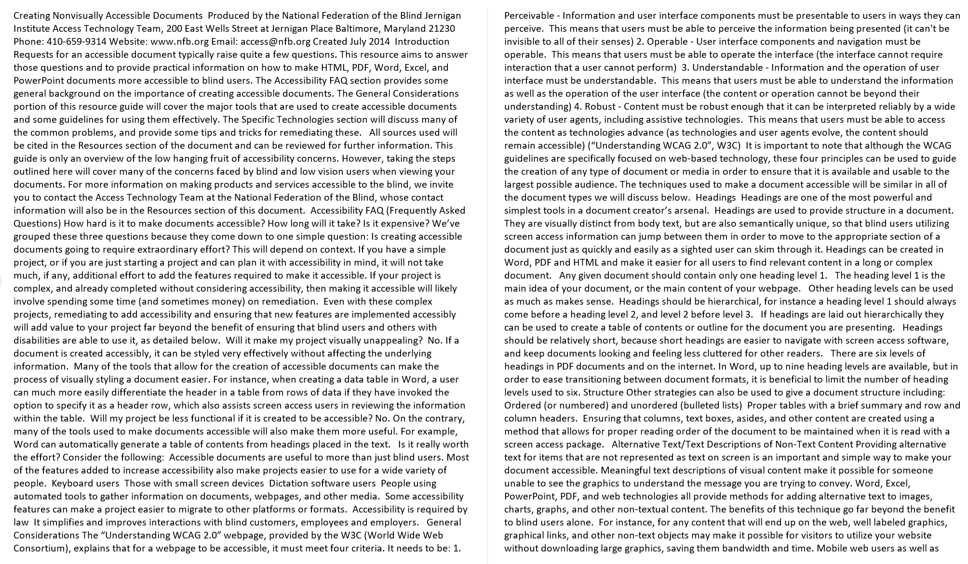
Documents: No Headings
ITS Accessibility – Create Inclusive & Accessible Experiences

Slide 20
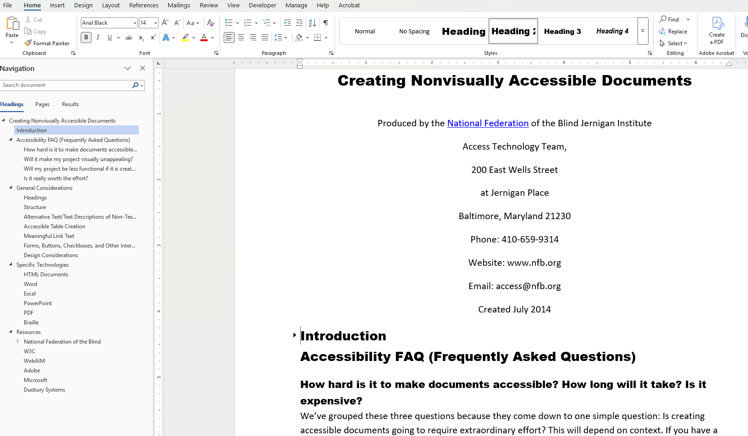
Documents: An Accessible Example
Tip: Turn on Navigation Pane in Word to see the structure. Click on View in the Ribbon and turn it on under Show section
ITS Accessibility – Create Inclusive & Accessible Experiences

Slide 21
High Impact Change 2: Rethink PDFs & Course Materials
Use Word or HTML (Blackboard page) when possible
Avoid scanned PDFs (can’t be read by screen reader)
Ensure readable formats (easily opened on any device & easy to understand)
Impact:
Easier access
Mobile friendly
Adaptable
When students can’t access the material, they can’t learn from it.
ITS Accessibility – Create Inclusive & Accessible Experiences
Notes:
If a student struggles to read a dense or poorly formatted document, and then performs poorly on an assignment, are we assessing their understanding—or their ability to navigate the format?

Slide 22
Example: Ensure Readable Formats (1/2)
Assignment Instructions:
Please read chapter 5 and write a 3–5 page paper discussing the major themes and how they relate to the concepts we discussed in class. Make sure to include examples. The paper should be typed and submitted by next Friday.
Students may struggle, not because of the content, but because of how it’s presented.
ITS Accessibility – Create Inclusive & Accessible Experiences
Notes:
Dense block of text
No structure or headings
Vague expectations (“major themes,” “examples”)
No clear connection to learning outcomes

Slide 23
Example: Ensure Readable Formats (2/2)
Objective:
Analyze major themes from Chapter 5 and connect them to course concepts.
What you need to do:
Identify 2-3 key themes from Chapter 5
Explain how each theme connects to course concepts
Include specific examples from the text
Format:
3-5 pages
Double Spaced
Submit as a Word document or PDF
Due Date: Friday October 15 by 11:59 PM
ITS Accessibility – Create Inclusive & Accessible Experiences
Notes:
Dense block of text
No structure or headings
Vague expectations (“major themes,” “examples”)
No clear connection to learning outcomes

Slide 24
High Impact Change 3: Add Alt Text for Images
Alt text is a short description of an image that allows screen readers to convey the same information to students who cannot see it.
Does an image convey information or evoke an emotion? Yes, include alt text. No, mark decorative.
Impact:
Ensures all student receive the same information
Improves understanding of course content
Benefits students using screen readers, with visual impairments, slow internet, and students reviewing content in different formats
If an image contains information and isn’t described, some students don’t have access to that content at all.
ITS Accessibility – Create Inclusive & Accessible Experiences
Notes:
In many cases, adding alt text takes less than 10 seconds, but it can make a significant difference
If you’re already explaining the image in class, you already know what to write as alt text.

Slide 25
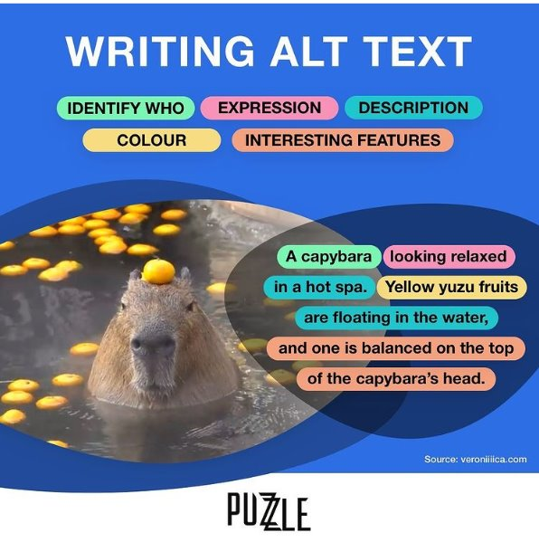
Images: An Example
Type of image (bar graph, drawing, cartoon, screenshot, etc.).
Text – All text should be written in alt text.
Who is in the image and where it’s located.
Color(s) – Use shade names such as cobalt blue for image details.
Expression and emotions depicted in the image.
Item locations and descriptions.
Interesting details users may want to know.
Link to data or transcript.
Source: Perkins School for the Blind
ITS Accessibility – Create Inclusive & Accessible Experiences

Slide 26
High Impact Change 4: Use Accessible Colors
Accessible color means ensuring there is enough contrast between text and background so all students can read your content easily.
Low contrast makes content hard or impossible to read
Affects:
  Students with low vision
  Color blindness
  Students on mobile devices or in poor lighting
Impacts:
Reading comprehension
Ability to follow instructions
Engagement
If students struggle to read your content, they’re spending energy on the format, not the learning.
ITS Accessibility – Create Inclusive & Accessible Experiences
Notes:
In many cases, adding alt text takes less than 10 seconds, but it can make a significant difference
If you’re already explaining the image in class, you already know what to write as alt text.

Slide 27
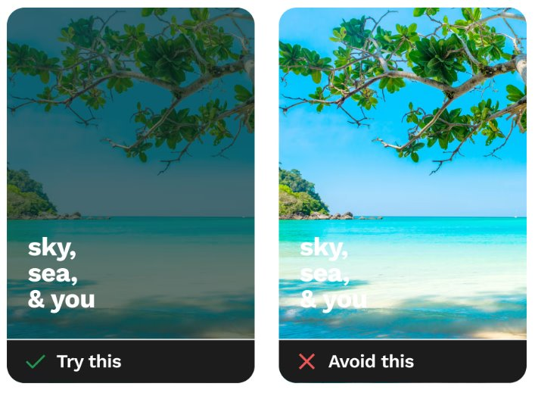
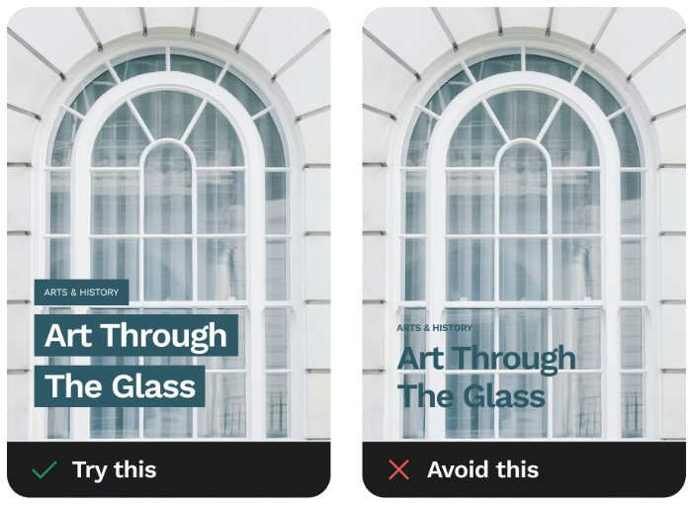
Colors: What Counts as Accessible?
Color Contrast
Color Blindness
3:1 ratio for 18pt font or higher.
4.5:1 ratio for less than 18pt font.
Use contrast checker tools:
  Color contrast ratio
  Color blindness simulator
Distinguish text from images.
Add labels or icons for information in addition to color.
Avoid red/black and red/green color combinations.
ITS Accessibility – Create Inclusive & Accessible Experiences

Slide 28

Colors: Inadequate Color Contrast
You don’t want to read this.
The ratio for these two colors is a 1.009:1 which is barely better than comparing a color to itself (1:1).
ITS Accessibility – Create Inclusive & Accessible Experiences
Notes:
The algorithms compare the two colors' relative luminance — which essentially boils down to whether one color is lighter or brighter than the other.
Here, tomato (ff6347) and cornflowerblue (6495ed) are pretty much equally bright, which is why they're difficult to read together.

Slide 29
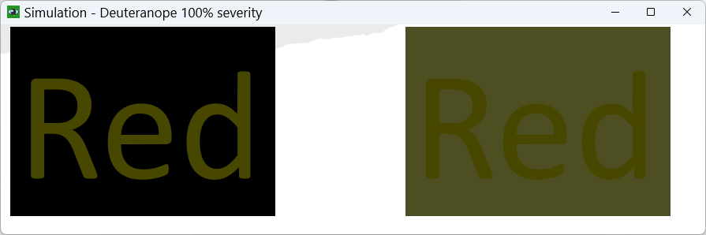
Colors: Red/Green Deficiency
Red
Red
ITS Accessibility – Create Inclusive & Accessible Experiences

Slide 30
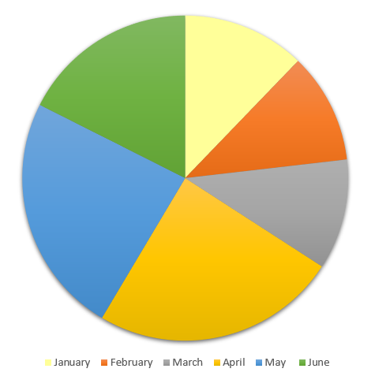
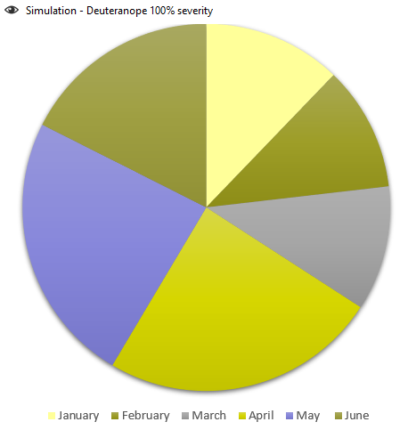
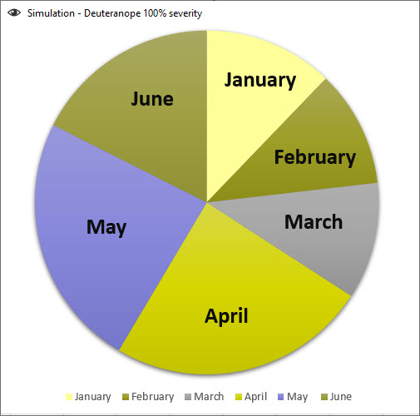
Colors: Inaccessible Colors
Don’t use color alone to convey information
ITS Accessibility – Create Inclusive & Accessible Experiences

Slide 31

Colors: Tools to Check Accessibility
WebAIM Website
Contrast Grid
Colour Contrast Analyser
Color Contrast Pal
Coolors
Browser Extensions such as Web Disability Simulator
ITS Accessibility – Create Inclusive & Accessible Experiences

Slide 32
High Impact Change 5: Use Accessibility Checkers
Use the built-in accessibility checkers in tools like Word, PowerPoint, and Blackboard to quickly identify and fix common issuesLow contrast makes content hard or impossible to read
Where to find them:
  Word/PowerPoint: Review → Check Accessibility
  Blackboard Ally: Accessibility indicators and Books & Tools → Accessibility Report LTI 1.3
  Students on mobile devices or in poor lighting
Helps you catch:
Missing alt text
Poor heading structure
Low color contrast
Missing table headers
Reading order issues
ITS Accessibility – Create Inclusive & Accessible Experiences
Notes:
In many cases, adding alt text takes less than 10 seconds, but it can make a significant difference
If you’re already explaining the image in class, you already know what to write as alt text.

Slide 33
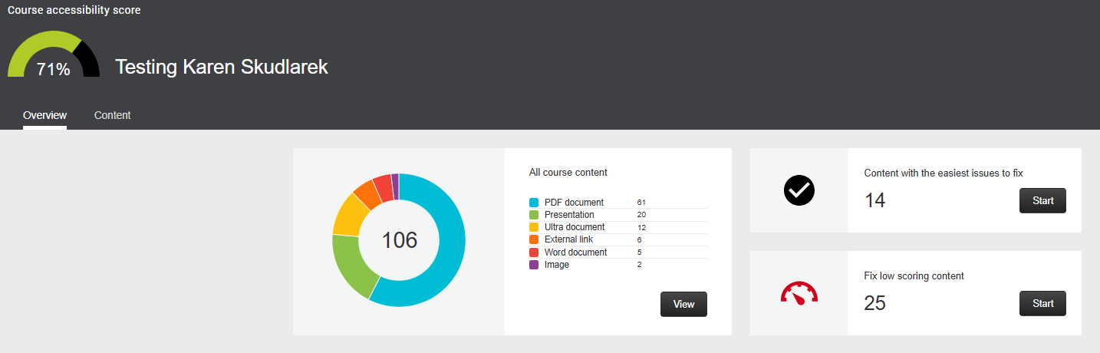
Blackboard Ally (1/3)
ITS Accessibility – Create Inclusive & Accessible Experiences

Slide 34
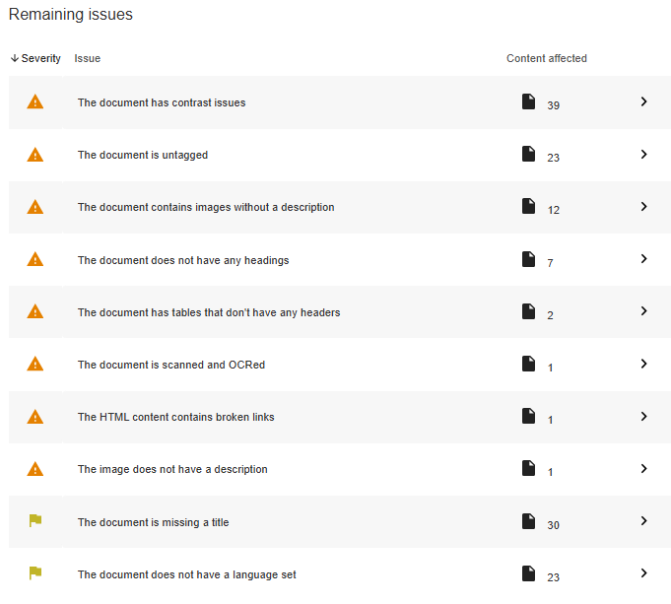
Blackboard Ally (2/3)
ITS Accessibility – Create Inclusive & Accessible Experiences

Slide 35
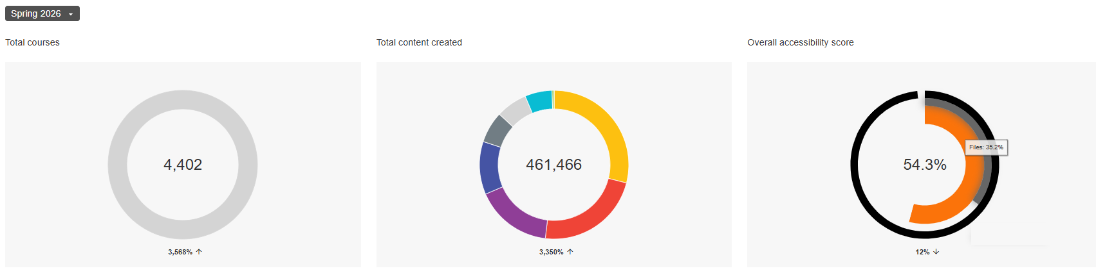
Blackboard Ally (3/3)
Content Created:
Images: 133,651
PDFs: 105,851
Ultra Document: 76,736
External Link: 53,210
Word Document: 31,534
Presentation: 27,188
ITS Accessibility – Create Inclusive & Accessible Experiences

Slide 36
Top 15 Accessibility Issues Spring 2026
The image doesn’t have a description (129, 562)
The document has contrast issues (60, 859)
The document does not have a language set (50,088)
The document is untagged (52,007)
The document contains images without a description (45,528)
The document is missing a title (44,316)
The document does not have any headings (33,296)
The documents has tables that don’t have any headers (15,428)
The documents is scanned but not OCRed (13,648)
The image has contrast issues (8,084)
The document’s heading structure does not begin at one (5,844)
The HTML’s heading structure does not begin at one
The HTML content has videos without captions
The HTML content contains links without discernable text
The HTML contents contains images without a description
ITS Accessibility – Create Inclusive & Accessible Experiences

Slide 37
High Impact Changes Summarized
Make Structure Visible
  Helps students navigate and understand content
Rethink PDFs and Course Materials
  Ensures materials are accessible and usable
Add Alt Text for Images
  Provides equal access to visual information
Use Accessible Colors
  Improves readability and reduces confusion
Use Accessibility Checkers
  Quickly identify and fix common barriers
Accessible design reduces barriers, so student performance reflects learning, not obstacles.
ITS Accessibility – Create Inclusive & Accessible Experiences
Notes:
In many cases, adding alt text takes less than 10 seconds, but it can make a significant difference
If you’re already explaining the image in class, you already know what to write as alt text.

Slide 38
What Can You Do Now?
Start with Small Change
Focus on High Impact Areas
Use the Tools Available to You
Reduce Future Work
Ask for Support
Build Over Time
ITS Accessibility – Create Inclusive & Accessible Experiences
Notes:
Select one Course
Select one material
Improve one thing
Examples:
Add headings to document
Clarify one assignment
Add alt text to a few images
Start where it matters most:
Assignments and instructions
Frequently used course materials
Content students struggle with
👉 Key message:
“Don’t start everywhere—start where it matters.”
Run the accessibility checker in Word or PowerPoint
Look at Blackboard Ally indicators
Use built-in templates and styles
👉 This reduces guesswork and saves time
Use accessible practices for new content moving forward
Avoid creating new inaccessible PDFs
Build accessibility into your workflow
👉 Key line:
“The easiest problems to fix are the ones you never create.”
Reach out to:
Instructional design
Accessibility support
IT or teaching centers
👉 Message:
“You are not expected to do this alone.”
Choose one improvement per week or per course update
Reuse improved materials
Let progress accumulate
👉 Key message:
“Accessibility is a process, not a one-time task.”

Slide 39
In Closing
This isn’t about perfection, it’s about progress, and it starts with one step.
ITS Accessibility – Create Inclusive & Accessible Experiences
Notes:
As you head back to your courses, the most important thing to remember is: you don’t have to redesign everything. Start small. Pick one course, one assignment, one document, and make one improvement. These changes, like adding structure, improving clarity, or using the built-in accessibility tools, don’t just support accessibility, they improve how students understand and demonstrate their learning. And over time, those small changes add up to courses that are clearer, more effective, and easier to teach.

Slide 40

Thank You!
ACCESSIBLE DIGITAL CONTENT
UConn ITS Accessibility
accessibility.its.uconn.edu

Slide 41
University of Connecticut Wordmark

